Slide 1
Project Builder:
A GPL continuous packaging solution
Bruno Cornec
WW Linux Community Lead, HP Open Source Profession
V2.2 October 2014
Notes:
<numéro>

Slide 2


Introducing Myself
Software engineering and Unices since 1988
  Mostly Configuration Management Systems, Build systems, quality tools, on multiple commercial Unix systems
  Discover Open Source & Linux (OSL) & first contributions in 1993
  Full time on OSL since 1995, first as HP reseller then @HP
Currently:
  Distinguished Technologist on OSL for HP EMEA Presales, Innovation Solution Center, Grenoble
  HP OSL Advocate and Converged Infrastructure Ambassador
  HP EMEA OSL Profession Lead
  Solutions Linux Conference and AFUL board member. Conferences at WW level in LinuxCon, Linux.conf.au
  MondoRescue, Project-Builder.org, UUWL and PUSK Project Lead
  LinuxCOE, mrepo, tellico, rinse, fossology, collectl contributor
  FOSSBazaar and OSL Governance enthusiast
  Mandriva, Mageia, Fedora packager
And also:
  Amateur singer (Alto / Tenor) and recorder player since 1976 and Choir director since 1987
  CD collector since 1981 (5000+ and counting) – Hundreds of concert attendance since 1976
  Amateur photograph since 1976
Notes:
This is Bruno's very short resume

Slide 3
What is project-builder.org’s goal ?
Make upstream projects life easier with regards to packaging their software

Slide 4
What is project-builder.org’s itch ?
Make my life easier with regards to packaging my software

Slide 5






Users / Sysadmins want packaged software
>= 90%
Ease of use: GUI, CLI
Distribution compliance
Smooth Integration with deployment tools Ambassador
Lag between SW and Pkg availability
Test of alpha/beta/VCS SW
Too many:
  distributions,
  versions,
  package formats,
  tools to generate packages
  tools to manage repositories
< 10%
U
< 1%
D
Notes:
Stats from sourceforge in 2010 but seems constant over the time

Slide 6

Upstream benefits from Continuous packaging
Packaging should be a project concern as well as coding, testing, installing, .... especially for smaller projects
Packaging as your only way of delivery (not a dream)
Minimal overhead, maximum benefit:
  Consistancy and reproduceability for devs and users
  Distribution & deployment server integration,
  Improved deployment without risk of screwing up the system
Packaging as a marketing activity for the upstream project. Easy way to extend your user base, and improve your community relationship and is a “competitive advantage”.
New mantra: “Package early, package always”
THE SOLUTION IS INDEED CONTINUOUS PACKAGING (whatever the tool)

Slide 7



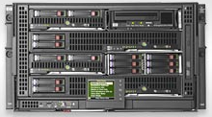
Continuous Packaging Architecture
Local Build Server (may host VMs and/or VEs)
Packagers
VM or VE Build
Repository
Server
Build +
metadata
Local build
Project
RM Build
Farm
(may host VMs)
Remote build
Developers

Slide 8
Goals
Project-builder main goal: help package continuously being agnostic
  VCS agnostic: no VCS but guys it's 21st century now, SVN, CVS, Mercurial, GIT and GIT/SVN, SVK....
  OS agnostic: Linux: RPM, deb, ebuild, slack based, ... 150+ distro tuples made and counting – repositories for yum, urpmi, apt. Solaris pkg. HP-UX sd in roadmap
  Build environment agnostic: local, VM (QEMU, KVM...), VE (chroot, Docker, rpmbootstrap, rinse, mock, debootstrap...), RM (build farm)
  No project impact: preserves the md5sum of the delivered upstream sources. Can be completely external to the upstream project.
  Avoids duplication of code and metadata
  THE SOLUTION IS INDEED CONTINUOUS PACKAGING (with project-builder.org !)

Slide 9
Various Virtualization architectures
Share
Dedicate
OS Virt
HW Virt
OS Resource Control
OS Virtualization
HW Virtualization
% CPU
% RAM
% CPU
% RAM
Container A
Container B
VM A
VM B
App. A
App. B
App. A
App. B
App. A
App. B
CPU bind
CPU bind
Env. A
Env. B
Env. A
Env. B
cgroups
NUMA
OS A
OS B
LXC / Docker
Operating System (OS)
Operating System (OS)
KVM
Hypervisor
Hardware
Hardware
Hardware
Single Kernel – Rresources cont.: shared cpu, memory, blkio, dedicated cpusets
Single Kernel - Enhanced chroot - Direct access to I/O devices - Isolation
Flexibility (multi OS)
Requires HW support
Kernel module
performance | good | best | good
isolation security | normal | good | best
runtime flexibility | best | good | normal
maintenance | best | normal | normal
Notes:
OS Virtualization:
Solaris Zones, enhanced chroot, LXC, OpenVZ
Share the same OS
Hardware virtualization:
Host OS and guest OS
KVM, VMware...
Hypervisor emulates HW for the guest OS
No restriction on the installed guest OS
VT-x, VT-d, VT-c (VMDQ, SR-IOV)

Slide 10
Linux Control Groups
Help to manage groups of processes
Dedicated subsystems to manage specific resources:
  Resource management: CPU shares, memory, blkio
  Resource pools: CPU sets, ns, freezer, checkpoint/restart
Implemented as a special cgroup file system
Cgroup commands: cgcreate, cgexec, cgclear, cgclassify, ...
Cgroup services :
  cgconfig (/etc/cgconfig.conf), defines cgroups and mount points
  cgred (/etc/cgrules.conf), defines rules between tasks and cgroups
These are provided by libcgroup on top of the kernel cgroup virtual file system to allow persistence across reboot and ease of use.
Docker associates a cgroup to each container
Share
Dedicate

Slide 11

Linux technologies for HW Virtualization
HW Virt
HW virtualization ('KVM' virtual machines)
Proposed in RHEL 5.4+/RHEL 6/RHEV and TP in SLES 11
Requires a kernel module and HW support
Applications in a VM are isolated from the others
  Security (Svirt)
  Fully separated environment (own OS, kernel, init, admin, user, network, PID)
  Paravirtualized drivers, PCI-Attach, SR-IOV.
  Excellent performances / Full transparency.
Can use all nice features (NUMA, cgroups, SELinux, iptables…) in the guest, if Linux, and on the host. 1 VM == 1 Linux process
Being part of the standard kernel : no specific certification required.
Supports X2APIC (reduce guest overhead), transparent huge pages, Async I/O
Notes:
cgroup:
Organizes processes into groups
Resources allocated to cgroups: cpuset, CPU shares
Children inherit properties from parent
Isolation:
Resource mgmt via control groups
same PID matches different users in different containers.
Kernel namespaces supported starting 2.6.19

Slide 12
Linux Containers
OS Virt
OS Virtualization example: ‘LXC / Docker’
Applications in a zone are isolated from the others
  Security
  New namespaces (own admin, user, group, network, PID, init)
  Granularity (sub-cpu granularity)
  Virtualization (underlying OS manages HW accesses)
  Performance / transparency: neither emulation nor full virtualization
Built upon cgroup resource management and namespaces
Other technos available
  V-Server
  Virtuozzo
  OpenVZ
Notes:
Global zone: privileged zone with access to all the resources.
Processes are bound to a zone.
Kernel has a field that links the process to the zone.
Zones, resource pools and workload management: all this can be put together.
We can imagine zones in resource pools controlling the accesses to their resources thanks to workload management.

Slide 13
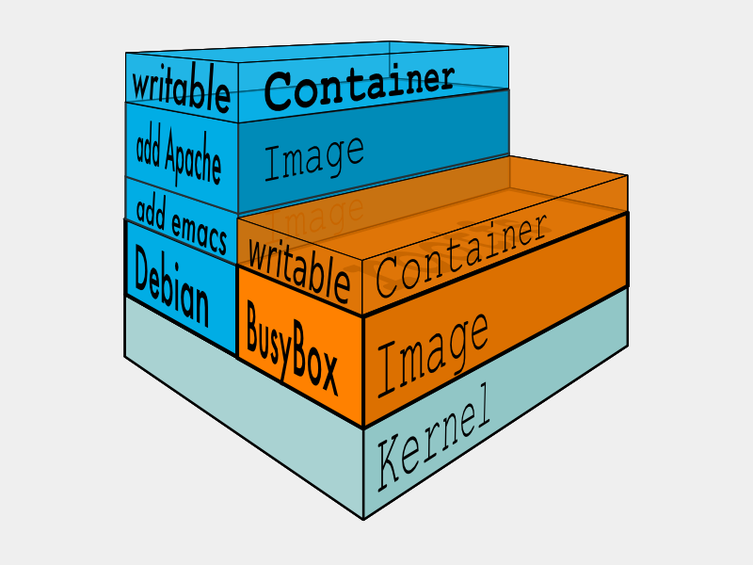
What is Docker ?
Docker main goal: run applications in containers in a neutral, lightweight and portable way
  Bundle: Everything packed together
  Layers: Images (ro) and containers (rw) can be build upon other images (using a union FS)
  Registry: public and/or private registry of images availability
  Dockerfile: descriptive build of an image
  Volumes: loopback mounting host FS into container
  Ports: expose container services port to the host
  1 application + its deps == 1 container

Slide 14
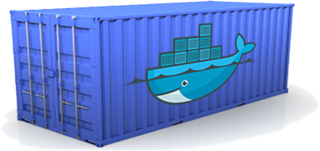
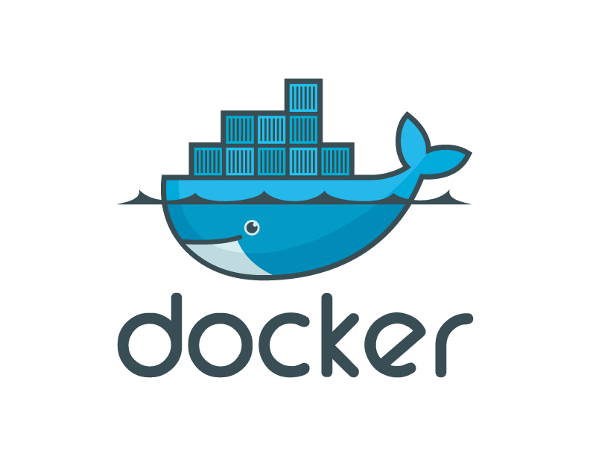
Continuous Packaging Architecture with docker
Local Build Server (hosting VEs)
Packagers
Docker containers
Repository
Server
Build +
metadata
Local build
Project
Developers

Slide 15

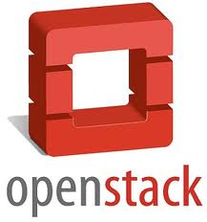
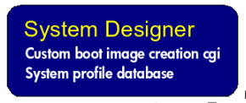

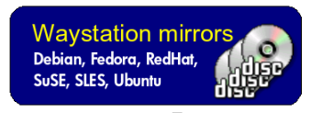


Provisioning the Continuous Packaging Cloud
Local Build Server (may host VMs and/or VEs)
VM or VE Build
Build +
metadata
Local build
Repository
Server
Project
RM Build Farm (may host VMs)
Remote build

Slide 16
Q & A up to now ?

Slide 17
Goodies
Project-builder provides additional goodies
  Easy VMs/VEs/RMs installation/setup. Update not mandatory.
  Macro system with perl variables to avoid duplication of metadata
  Skeleton generation to help starting
  Manages package delivery up to your repository (ssh based) with repository management (yum, apt, urpmi)
  Integration of tests in the process
  Manages patches/additional sources when not upstream
  Checks validity of packages built (lintian, rpmlint)
  Easy creation of new versions for upstream management
  Manages website delivery, announces on mailing-lists

Slide 18
VM, VE & RM Management
Phase 0
  VE Creation
  debootstrap for .deb based ones.
  rpmbootstrap (modeled after debootstrap): create chroot for multiple RPM based distributions (Mageia, Fedora, Mandriva, CentOS, OpenSuSE)
  Reuse of existing docker containers (TBD)
  VM|RM Creation
    KVM or QEMU iso install possibilities.
    LinuxCOE/OpenStack as provisioning tool for your VM|RM

Slide 19
VM, VE & RM Management (cont.)
Phase 1
  VM|VE|RM setup: adds pb tools and build account
Phase 2
  VM|VE|RM preparation: adds project build dependencies
Phase 3
  Build project in VM|VE|RM (== local build for the VM|VE|RM)
VM|VE Snapshot feature
ssh communication for VM/RM

Slide 20
Docker containers Management
Phase 0 (tag: d-v-a) - newve
  Local Image Creation (debootstrap/rpmbotstrap)
  Reuse Image from Docker Registry
Phase 1 (tag: d-v-a-pb) - (sbx2|)setupve
  adds pb tools and build account
Phase 2 (tag: d-v-a-pb-proj) - prepve
  adds project build dependencies
Phase 3 (container) - build2ve
  Build project in the Docker container
Minimal OS Image
Image + pb tools
Image Proj1 deps
Image Proj2 deps
Proj1 container
Proj2 container

Slide 21
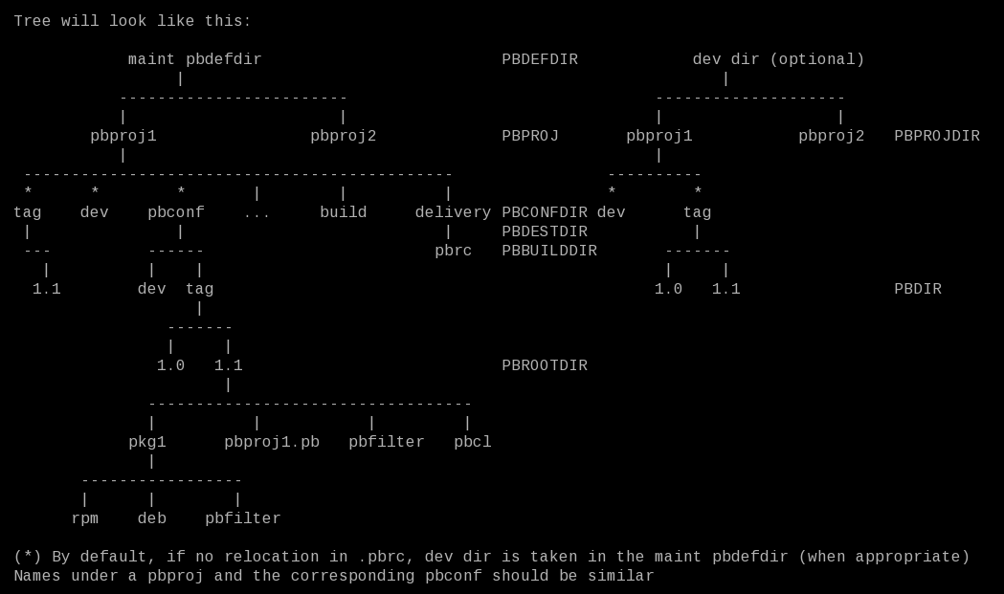
Metadata Management
Packaging process independent of the project and external
Metadata isolated - No duplication

Slide 22
Configuration file usage
Macro example:
./rpmbootstrap/pbfilter/all.pbf:filter PBSUMMARY = rpmbootstrap is a tool similar to debootstrap for RPM based distributions
./rpmbootstrap/rpm/rpmbootstrap.spec:Summary: PBSUMMARY
./rpmbootstrap/deb/control:Description: PBSUMMARY
./rpmbootstrap/pkg/pkginfo:NAME="PBSUMMARY"
Instantiation possible from distro-ver-arch, distro-ver, distro, distro-family, distro-type, os
Similar approach for all other parameters (Cf: man pb.conf)
Metadata isolated - No duplication
Packaging process independent of the project and external

Slide 23
Commands
[cms|sbx]2build: Create tar files for the project under your CMS. Parameters are packages to build if not using default list
build2pkg: Create packages for your running distribution
build2ssh: Send the tar files to a SSH host
pkg2ssh: Send the packages built to a SSH host
build2vm|ve|rm: Create packages in VMs/VEs/RMs, launching them if needed and send those packages to a SSH host once built
launchvm: Launch one virtual machine
script2vm|ve|rm: Launch a VM/VE/RM if needed and executes a script on it
test2vm|ve|rm: Test inside a VM/VE/RM
newvm|ve: Create a new VM/VE/RM
setupvm|ve|rm: Setup a VM/VE/RM for pb usage
newver: Create a new version of the project derived from the current one
newproj: Create a new project and a template set of configuration files under pbconf

Slide 24
The Big picture
Packagers
newver / newproj
newvm|ve / setupvm|ve|rm
Packaging
build2vm|ve|rm
cms|sbx2build
Project
Building
Packages
build2pkg
pkg2ssh
Developers
build2ssh

Slide 25
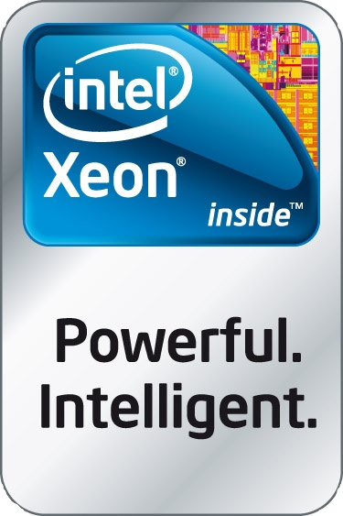

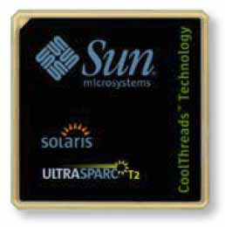

Multi platform life cycle
User Requirements
Validation
Functional
Specification
Integration tests
Design
Specification
Unit tests
Coding

Slide 26
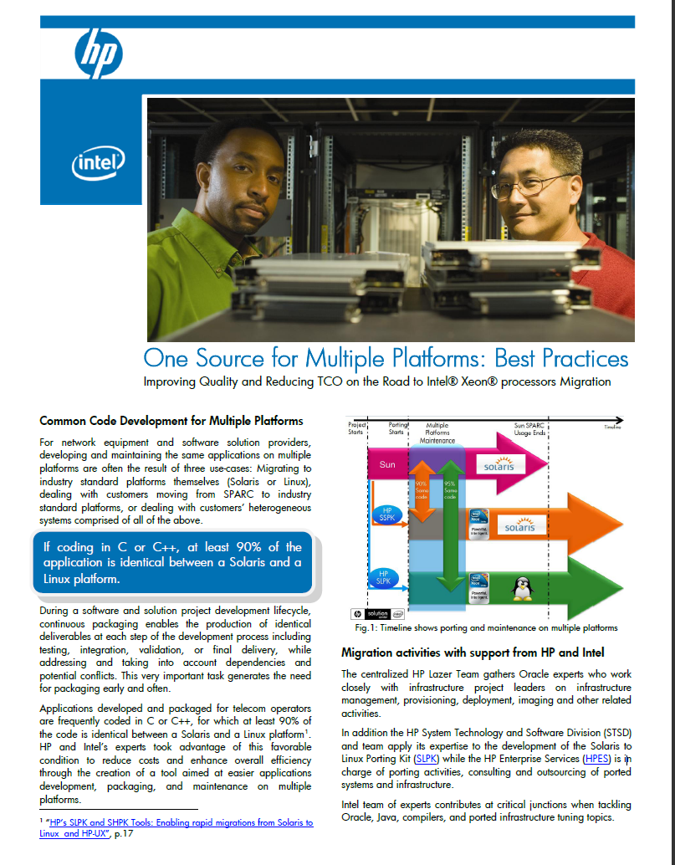
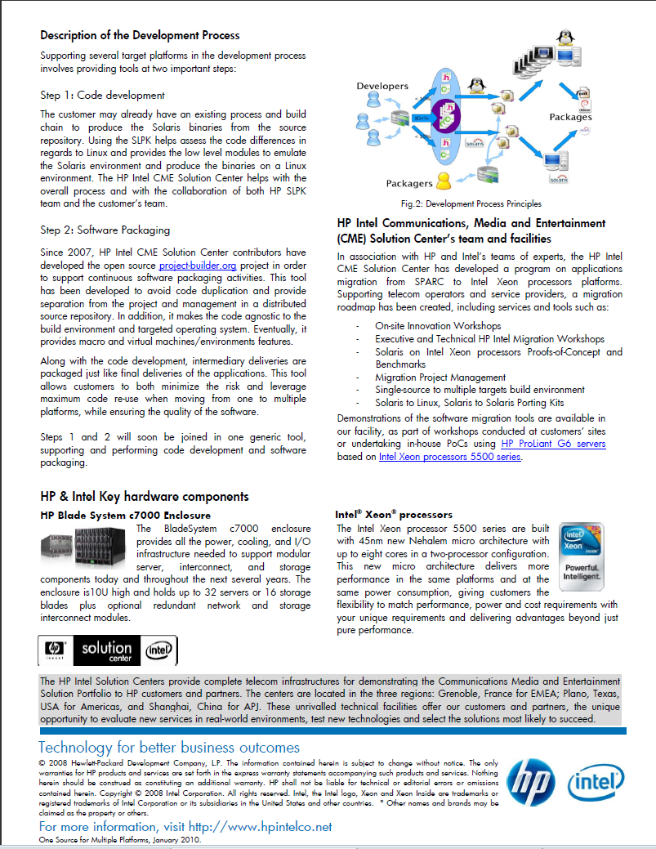
HP+Intel Solution Brief

Slide 27





Multi platform development cycle
.o
.o
.o
.o
.o
.o
.o
< 5%
UUWL
.a
.o
.o
90+%
.o
.o
.o
.o
UUWL
.a
.o
.o
< 10%
.o
.o
.o
.o
.o
.o

Slide 28

Multi platform packaging cycle
VMs/VEs/RMs
Developers
UUWL
Packages
VM/VE/RM
Packagers

Slide 29
Q & A up to now ?

Slide 30
DEMONSTRATION

Slide 31
To be done
Support for libvirt, virsh, openstack API, LXC (?)
Other CMS (Bazaar, …) only when/if needed
Other VMs (VMWare, Xen, ...) only when/if needed
Multiple delivery means – usage of ansible ?
Look at interactions with Buildbot
Add non-interactive signature support for .deb
Config-Model for configuration file management
REST API and Web Interface would be nice. Any contributor ?

Slide 32
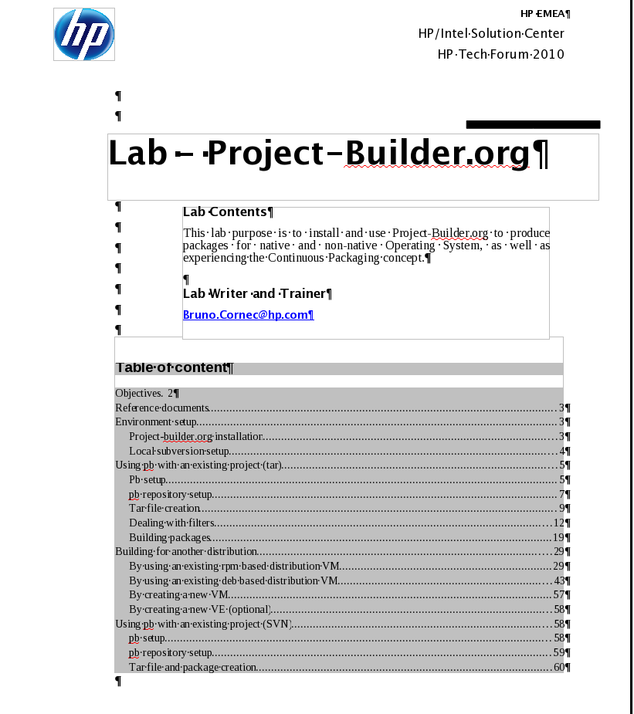
Learn Project-Builder.org
Start with the Lab (63 pages)
Use man (pb, pb.conf + 8 ProjectBuilder::* man pages)
Use the mailing-list pb-announce and pb-devel at http://www.mondorescue.org/sympa
Use examples from http://trac.project-builder.org/browser/projects/

Slide 33
Web Resources
Related tools
Project-Builder.org Web sites:
http://www.project-builder.org
http://trac.project-builder.org
Projects using project-builder.org:
http://www.project-builder.org (of course :-)
http://www.mondorescue.org
Http://www.linuxcoe.org
http://www.fossology.org
Project-Builder.org is mostly suited for upstream projects wanting to package their applications
Distributions provide each their build tools
  SuSE: Open Build Service (Multi distro, Web based, BaaS)
  Fedora (Koji)
  Mandriva/Mageia (Youri, mdvsys, mgarepo...)
Other complementary tools:
  Buildbot
  Parallel::ForkManager, DBI, DB::SQLite, File::MimeInfo, Mail::Sendmail

Slide 34

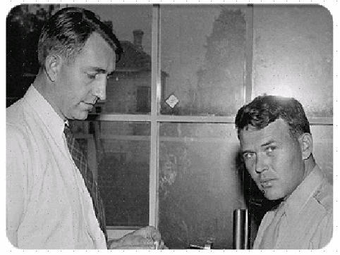

Bruno_Cornec@hp.com
(Open Source &Linux Strategist in the HP EMEA Innovation Solution Center)
http://www.hp.com/linux
  Linus Torvalds, Richard Stallman, Eric Raymond, Nat Makarevitch, René Cougnenc, Eric Dumas, Rémy Card, Bdale Garbee, Bryan Gartner, Gallig Renaud, Joachim Langenbach among others, for their work and devotion to the Open Source Software cause... and my family for his patience :-)
Contact
”Changes are never easy to make.
There is comfort and safety in tradition, but change must come, no matter how painful or expensive it may be.”
Bill Hewlett
Thanks
Open Source at HP
http://opensource.hp.com

